Slide 1
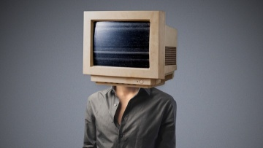
A tour to COMPUTERS
Notes:
This presentation demonstrates the new capabilities of PowerPoint and it is best viewed in Slide Show. These slides are designed to give you great ideas for the presentations you’ll create in PowerPoint 2010!
For more sample templates, click the File tab, and then on the New tab, click Sample Templates.

Slide 2
1. Through this lecture, students will visualize the journey of computer.
2. Students will be acquainted with basic computer jargon, working, input and output devices.
3. Students will learn different fields affected by computers.
Learning
Outcomes

Slide 3
What is Computer?

Slide 4
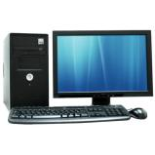
Electronic
Programs
Digital

Slide 5
How Computer Works?

Slide 6

1
2
3
4
Accept and gather data
(INPUT)
Process data to become information
(PROCESSING)
Stores data and information
(STORE)
Presents information
(OUTPUT)

Slide 7
Parts of Computer

Slide 8
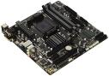
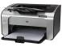
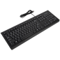
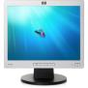
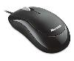
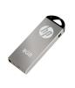
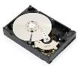
Input
Process
Output
Storage

Slide 9
What is CPU?

Slide 10
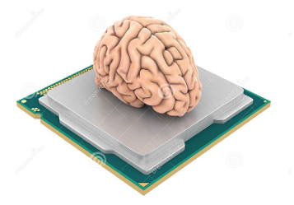
ALU
Arithmetic operations
Logical operations
Execute complex tasks
CU
Coordinates all CPU activities
Controls flow of information
Interprets memory and signals other parts

Slide 11
Input Devices

Slide 12
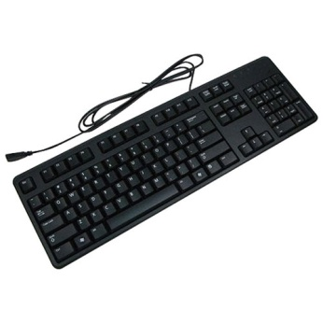
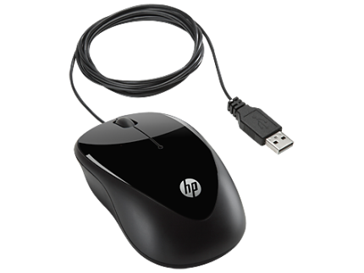
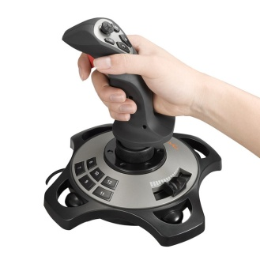
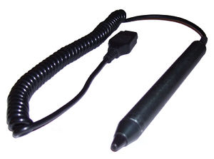
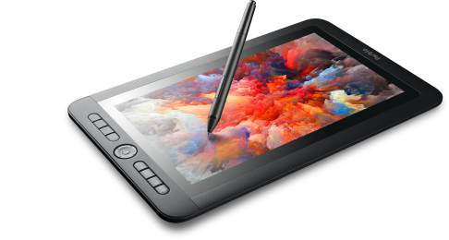
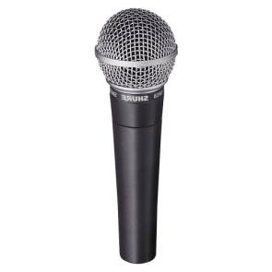
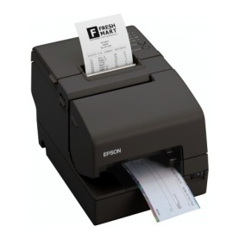
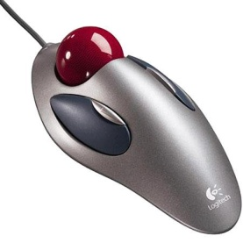
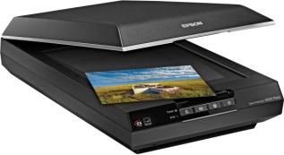
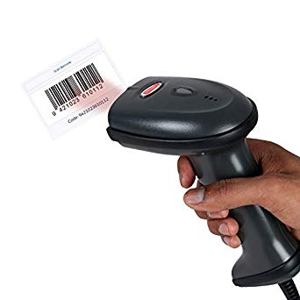
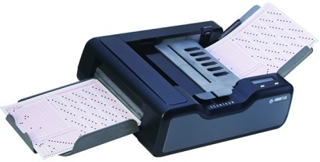
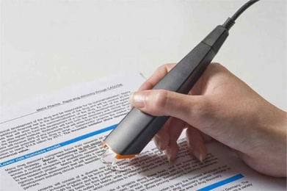

Slide 13
Output Devices

Slide 14
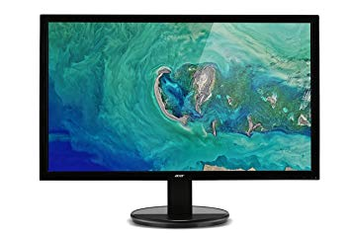
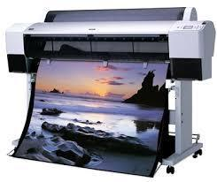
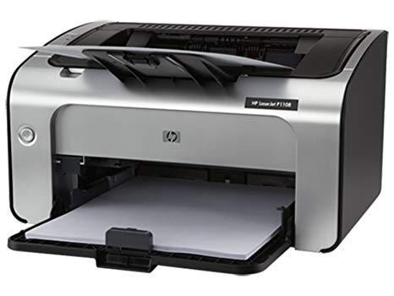

Slide 15
Quiz

Slide 16
Puzzle 1
1. Helps recognise the text in images into machine readable content
2. One of the most common uses is in banks to handle handwritten texts

Slide 17
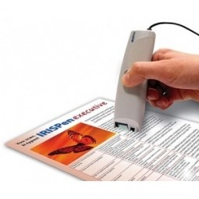
Optical Character Recognition (OCR)

Slide 18
Puzzle 2
1. Light sensitive device
2. Converts drawing, printed text or images into digital form
3. Create digital copies of photographs to post on networking sites

Slide 19

Scanner

Slide 20
Puzzle 3
Used to control machines such as cranes, trucks, wheelchairs, surveillance cameras etc.
originated as controls for aircraft ailerons and elevators
Used to replace the computer mouse for people with fairly severe physical disabilities.

Slide 21
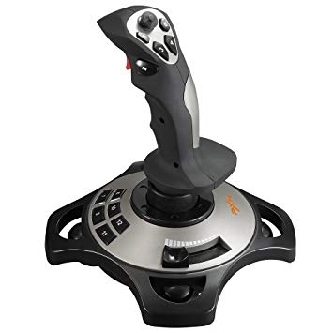
Joystick

Slide 22
Puzzle 4
Draw pictures on paper using a pen.
Used primarily in technical drawing and CAD applications.
Used in creating tactile images for visually handicapped people on special thermal cell paper

Slide 23
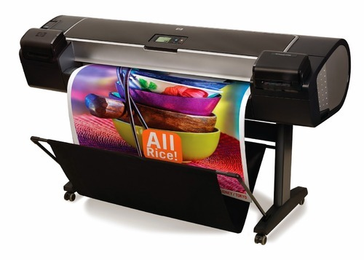
Plotter

Slide 24
Types of Memory

Slide 25
Types of Memory
1. Cache memory-bufer between CPU and main memory.
2. Holds data frequently used by CPU.
3. Faster than main memory
4. Expensive, limited capacity.
5. Stores data for temporary use.
1. Main (Primary memory) holds data currently used.
2. Limited capacity, data lost when power is off.
3. RAM and ROM
4. Faster than secondary memory
5. Computer can’t run without it.
1. Secondary/external / non-volatile memory.
2. Stores data permanently.
3. CPU can’t access, rather IO devices access.
4. Slower than primary
5. Examples: Disk, CD-ROM, DVD etc.

Slide 26
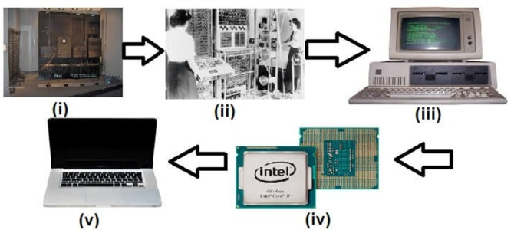
5 Generations of Computer

Slide 27

The Journey..

Slide 28
Enormous, expensive, generates lot of heat
UNIVAC and ENIAC
Vacuum tubes for circuitry & magnetic drums for memory
Users interacted with keyboards and mouse and interfaced with OS
Integrated circuits developed, transistors placed on silicon chips
Run multiple applications at one time.
IBM 1620, 7094, CDC 1604, 3600, UNIVAC 1108
Assembly language, FORTRAN, COBOL
magnetic cores as primary memory and magnetic tape and magnetic disks as secondary storage devices.
Transistors were used, cheaper, less power, less heat, faster, more reliable

Slide 29
DEC 10, STAR 1000,PDP 11,CRAY-1(Super Computer), CRAY-X-MP(Super Computer)
superconductors as raw material
Intelligent computers, based on artificial neural networks or “artificial brains”
Desktop, Laptop, Notebook, UltraBook, ChromeBook
C and C++, Java, .Net
Parallel processing and Artificial Intelligence
VLSI became ULSI
Time sharing, real time networks, distributed operating system
Used VLSI, microprocessors
Multiple processing units operating simultaneously.

Slide 30
Types of Computer

Slide 31
Types of Computer
PC
Mini
Computer
Super
Computer
Work
Station
Main
Frame

Slide 32
Types of Computer contd.
Super
Computers
1. Large, expensive
2. Handle hundreds or thousands users simultaneously.
3.Execute many programs concurrently
1. Fastest, expensive
2. Specialized applications like weather forecasting, simulations, nuclear energy etc.
1.Single user, powerful microprocessor.
2. Moderate power, high quality graphics.
3. OS: Unix, Windows NT
1. Multi-processing
2. Handle 250 users simultaneously
PC
WorkStation
MiniComputer
MainFrames
Small, inexpensive, single-user.
Based on microprocessor technology

Slide 33
Quiz

Slide 34
Puzzle 1
Distribute computing chores to thousands of CPU’s
Useful in varied applications like weather forecasting, scientific research, oil and gas exploration
One of the first designed in 1964 by Seymour Cray

Slide 35

Supercomputers

Slide 36
Puzzle 2
1. Netflix, Google , Facebook use cloud computing to share resources. Cloud computing thus helps them save infrastructure costs .
2. Can you guess what resources are we taking about?

Slide 37
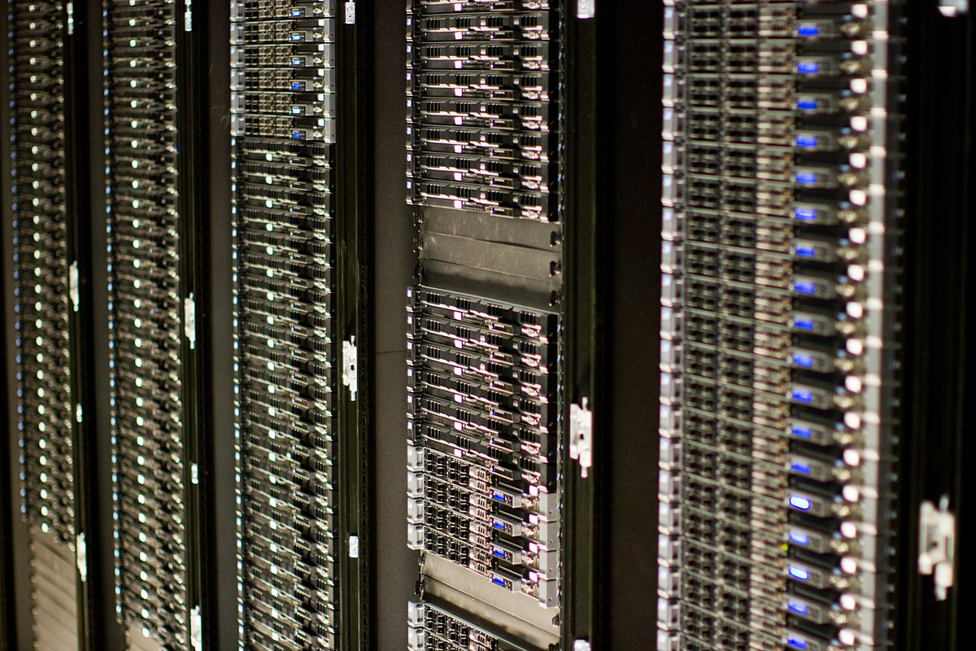
Server

Slide 38
Puzzle 3
Developed in mid-1960s
Name coined for a system that lies in between that of micro and main frame systems
Companies such as DEC, HP and Data General marketed this series of systems

Slide 39
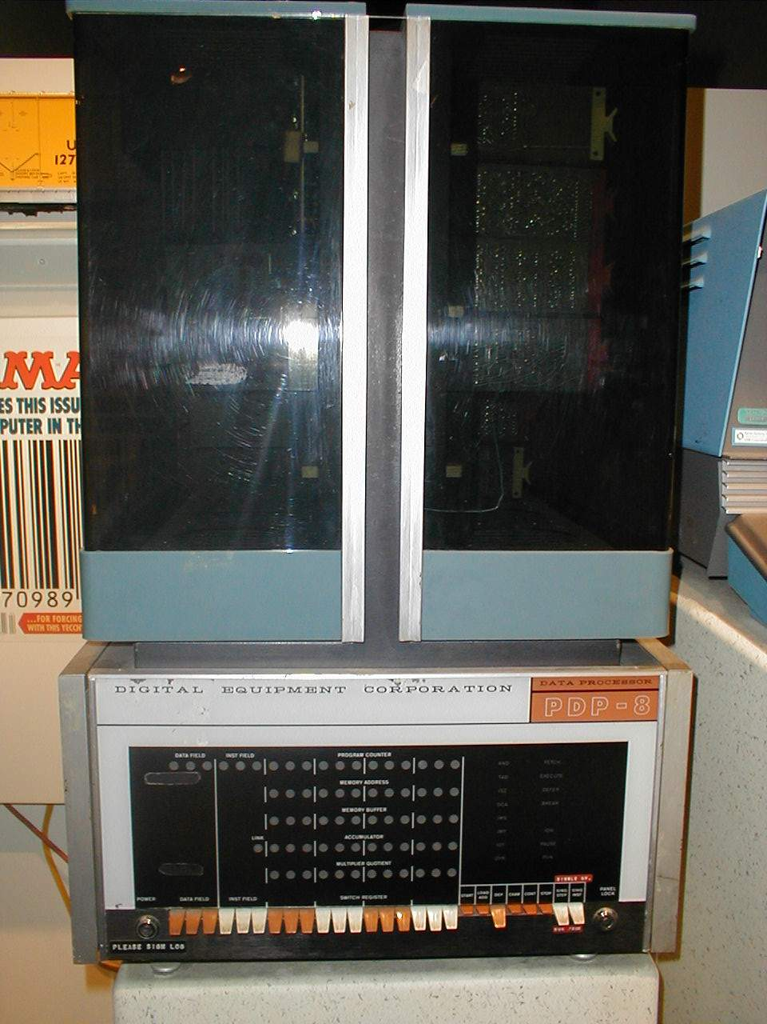
MiniComputers

Slide 40
Puzzle 4
composed of a disk of thin and flexible magnetic storage medium
Have three basic sizes: 8-inch, 51/4 –inch, 31/2 -inch
less storage capacity, less expensive and portable.

Slide 41
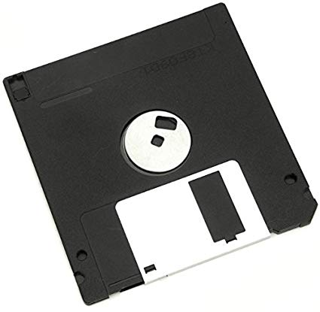
Floppy Disk

Slide 42
Hardware and Software

Slide 43
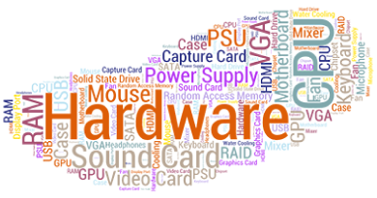
Computer Hardware and Software
System Software
File Mgmt. Tools
Assembler
Utilities
Operating Systems
Debugger
Compiler
Application Software
Word Processing
Games
Graphics
Spreadsheets
Communication
Databases

Slide 44
Applications

Slide 45
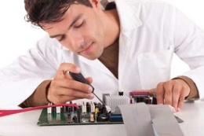
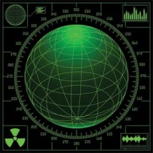
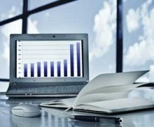

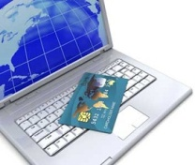
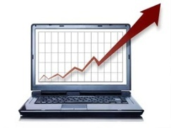
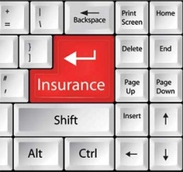
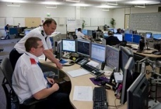


Engineering Design
Military
Business
Healthcare
Computer
Banking
Marketing
Insurance
Government
Communication
Education

Slide 46

Quiz

Slide 47
Q1. Which of the following retains the information it’s storing when the power to the system is turned off?
CPU B) ROM C) RAM D) DIMM
Q2. The term used to define all input and output devices in a computer system is ____
A) Monitor B) Software
C) Shared resources D) Hardware
Q3. Information that comes from an external source and is fed into computer software is called ____
A) Input B) Output
C) Throughput D) Reports
Q4. The most common method of entering text and numerical data into a computer system is through the use of a ____
A) Plotter B) Scanner
C) Printer D) Keyboard
Q5. ENIAC Computer belongs to __________.
A) First Generation B) Second Generation
C) Third Generation D) Fourth Generation

Slide 48
Q6. __________ is used as a programming language in first generation computers?
A) FORTRAN B) COBOL C) BASIC D) Machine Language
Q7. FORTRAN stands for __________.
A) For Translation B) Format Transformation
C) Fork Transformation D) Formula Translation
Q8. Batch processing was mainly used in this generation. A) 1st B) 2nd C) 3rd D) 4th
Q9. The period of ________ generation was 1952-1964. A) 1st B) 2nd C) 5th D) 4th
Q10. ______________ leads to concurrency. A) Serialization B) Parallelism C) Serial processing D) Distribution

Slide 49
Lets’ explore more…
Students to be divided in groups of 3.
Have to present topic allotted.
Time to prepare: 30 minutes

Slide 50
Presentation Topics
Printers and Plotters- their working, how they are different
Applications of computers in Military
Applications of computers in Manufacturing Industry.
Light pen- working, usage in different areas
Optical Character Reader- working, usage in different areas
Journey of supercomputers and its current usage
Journey of mobile devices with recent developments
How computer starts and loads operating system?

Slide 51
Thank You

